Slide 1

LOAN CLASSIFICATION MIT ADSP
YASH RANA, JAN 2022

Slide 2
Table of Contents
Problem we are trying to solve 3
Why are we solving this problem 4
Industry Outlook 5-6
Goals 7
Key Question 8
Our Data Set 9-10
Problem and Solution Summary 11-16
- Part 1: Proposed Approach
Part 2: Final Solution Design
Executive Summary 17
Recommendations and Next Steps

Slide 3

OUR PROBLEM
- Build a classification model to predict clients who are likely to default on their loan and give recommendations to the bank on important features to consider while approving a loan!

Slide 4
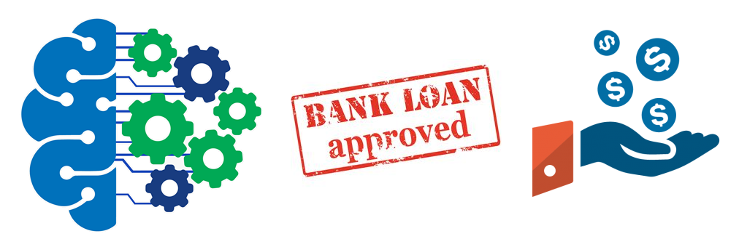
Why is this important to solve?
What is one thing we all have in common? We all love Ben Jerry’s Half-baked Ice cream? We all love Messi over Ronaldo? Okay, okay, these are all the things that only apply to me. Although we probably share many common things in a variety of spectrums it is safe to say one thing we all need or use around the world is, MONEY! Money, or capital, is deposited, withdrawn, invested, and most importantly lent through financial institutions (banks, etc.). Beside those irksome fees, banks make most profit through interests in the form of home loans, also known as line of credits or simply mortgages. When a client defaults on these loans, the bank can face a major loss in their profits, and if too many clients default in the long run it can affect other client’s investments and interests on saving deposits. So it impacts us all. This is why the approval process for a loan is multi-layers. The bank wants to make sure you are capable of paying back the debt in a timely and efficient matter. This process is long and can face a lot of human errors and biases when assessing.

Slide 5

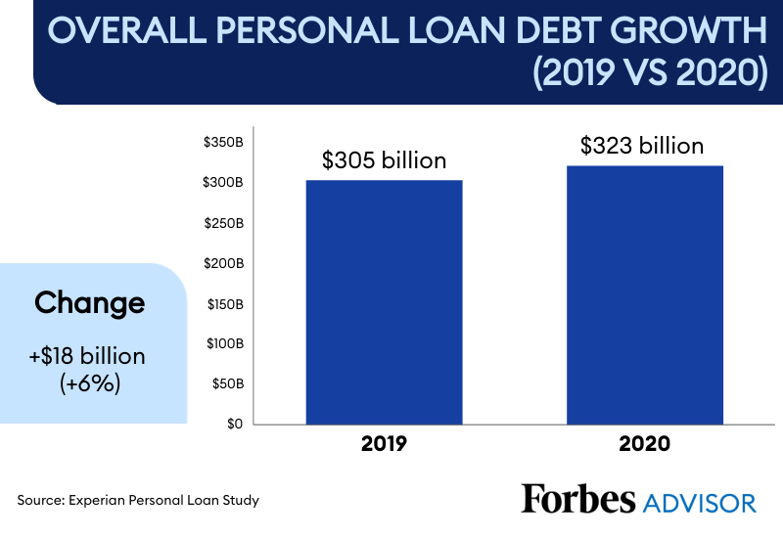
INDUSTRY OUTLOOK
Loan statistics during the pandemic
Overall personal loan debt is growing like crazy over the pandemic
Banks became more reluctant to lend money out because it was a risky bet with millions of Americans dealing with job loss, making it more difficult to afford monthly payment obligations
Reference:
https://www.forbes.com/advisor/personal-loans/personal-loan-debt-statistics-during-the-pandemic/

Slide 6
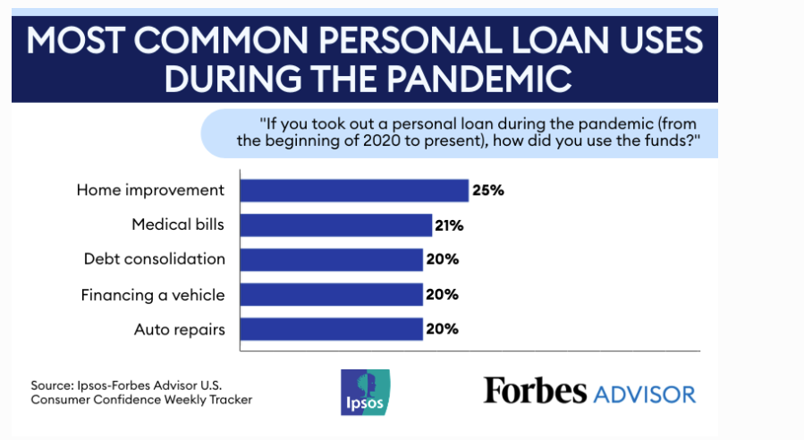
INDUSTRY OUTLOOK
Consolidation debt and home improvement were the primary reason for applying for a personal loan. In our data analysis we shall look at both reasons
Reference:
https://www.forbes.com/advisor/personal-loans/personal-loans-pandemic/

Slide 7


What is our goal?
Now with the ever growing world of data science and machine learning, banks want to achieve an algorithm or model that will accurately identify whether a client will be capable of paying back their loan or not without biases and extensiveness. . At the same time, one important thing to keep in mind is to make sure that the machine does not take into account or learn from previous biases and errors because of the human approval process. This machine learning model will allow banks to continuously learn from incoming data to continue being accurate and update accordingly by running on a cloud platform. This model is hoped to save time and money for the bank by eliminating risk and also allowing clients to apply and be approved for loans online rather than coming to talk to an advisor in person.

Slide 8

Key Questions
What are the clients net worth and monthly income?
Their debt-income ratio?
Who are they? What kind of career or employment do they have?
What are their assets? House, cars, etc?
Information on their current debt? How much they owe? How long as their debt been open for? Credit Score?

Slide 9
OUR DATA SET
BAD: 1 = Client defaulted on loan, 0 = loan repaid
LOAN: Amount of loan approved.
MORTDUE: Amount due on the existing mortgage.
VALUE: Current value of the property.
REASON: Reason for the loan request. (HomeImp = home improvement, DebtCon= debt consolidation which means taking out a new loan to pay off other liabilities and consumer debts)
JOB: The type of job that loan applicant has such as manager, self, etc.
YOJ: Years at present job.
DEROG: Number of major derogatory reports (which indicates a serious delinquency or late payments).
DELINQ: Number of delinquent credit lines (a line of credit becomes delinquent when a borrower does not make the minimum required payments 30 to 60 days past the day on which the payments were due).
CLAGE: Age of the oldest credit line in months.
NINQ: Number of recent credit inquiries.
CLNO: Number of existing credit lines.
DEBTINC: Debt-to-income ratio (all your monthly debt payments divided by your gross monthly income. This number is one way lenders measure your ability to manage the monthly payments to repay the money you plan to borrow.

Slide 10
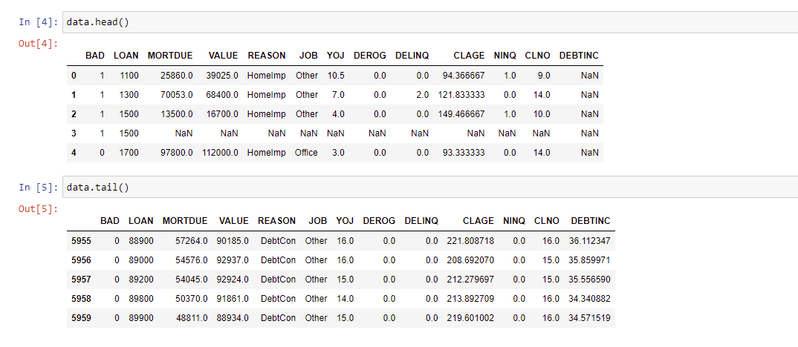
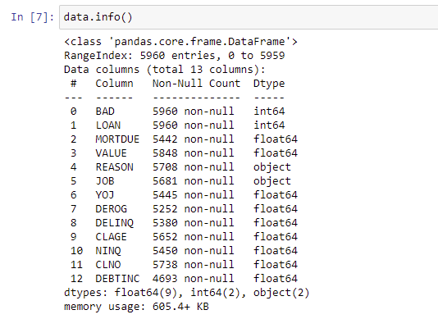
OUR DATA SET

Slide 11

Problem and Solution Summary Part 1- Proposed Approach Please see attached Jupyter Notebook for in-depth coding and analysis
A) Potential Techniques Used
Using EDA compare numerical and categorical variables of the data
Potential Techniques Approached after EDA
Logistic Regression
Decision Tree
Random Forest
3) Improved model performance and reduced overfitting using techniques such as- GridSearchCV/Randomized SearchCV/Pruning/etc.
4) Finding cost of the model

Slide 12
Problem and Solution Summary Part 2- Final Solution Design Please see attached Jupyter Notebook for in-depth coding and analysis
Checked data description and got basic statistics and summary of data
B) Performed Univariate analysis to see how data is spread out for different variables and identified outliers
C) Performed Bivariate analysis to see how different attributes vary with the dependant variable
D) Outlier treatment not performed. Missing value treatment performed by replacing numerical missing data with median and categorical missing data with mode
E) Future Engineering-transforming features
D) Choosing recall as our model evaluation metric. Lowest bank cost error.
E) Splitting the data and completing different models (logistic regression, decision tree, random forest).
F) Model tuning to see if the performance of the model can be further improved (optimal threshold, GridSearchCV, Random Forest Optimizer, Class weights, pruning, etc.
G) Checking model cost on test data. Cost Matrix is similar of confusion matrix except we only look at True Positives and True Negatives as they are correctly identified. We are also estimating cost on test data because its what predicts on new data that comes in after the model has been built.

Slide 13
Final Solution Design Cont..
- Bank wants recall to be maximized, the greater the recall the higher chances of minimizing false negatives. Hence, our focus is increasing recall score or minimizing false negatives. In other terms we can say that we are trying to identify the positives (class 1) so the bank can minimize the bad loans/defaults.
BAD: 1 = Client defaulted on loan, 0 = loan repaid
- Reading confusion matrix: 1- loan default is positive . 0-loan repaid is negative
True Positive: Predicting the customer will not pay back their loan and they dont
False Negative: Predicting the customer will pay back their loan but they end up defaulting
True Negative: Predicting the customer will pay back their loan and they do
False Positive: Predicting the customer will not back their loan and they do

Slide 14


Key points that describe the final proposed solution design
Most important factors that drive default are DEBTINC_missing_values_flag, DEBTINC, DELINC, and CLAGE
In DEBTINC_missing_values_flag we saw customers indicating presence of missing value in DEBTINC tend to have higher chances of defaulting. To improve future model we need find why these values were not reported by clients. When the missing values were filled in with median it gave high importance
In DEBTINC we saw customers whose DEBTINC value is higher have higher chance of defaulting. So they have more debt than monthly income.
In DELINC we saw customers who have higher delinquencies have a higher chance of defaulting as it shows inconsistency on payments
In CLAGE we saw customers with low value of average credit line age in months have higher chance of defaulting. Generally, the longer an account has been open and active with positive payments the better it is for your credit score
Tuned Random Forest has best recall on test data followed by weighted random forest. See next slide

Slide 15

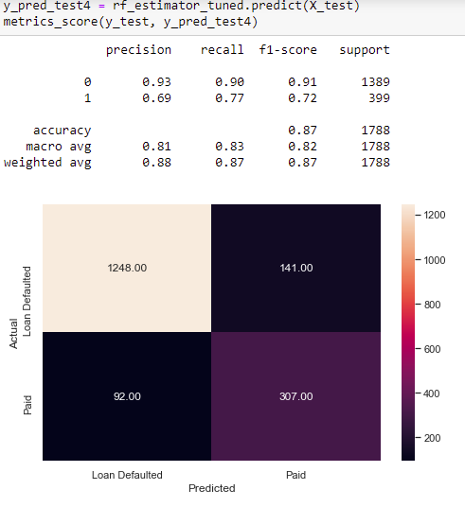
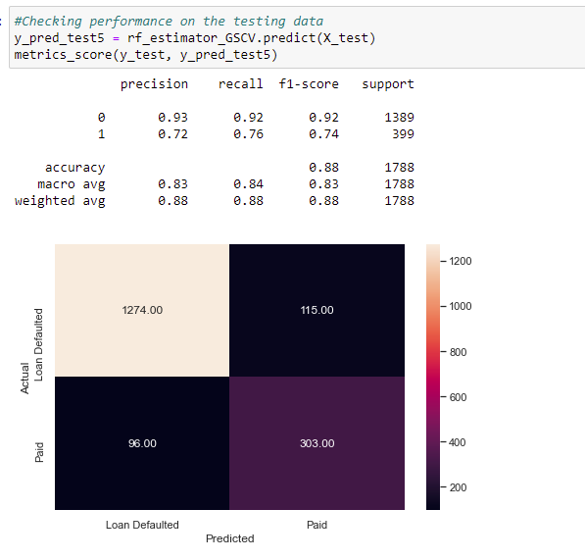
Best Model
Tuned RF
Cost of model- 119800
RF with class weights
Cost of model-145600

Slide 16

Problem Solution Summary: Why is this a 'valid' solution that is likely to solve the problem?
After reaching the best model performance and obtaining optimum features we can you this to solve the problem because it shows who is at risk of defaulting and can allow banks to take appropriate action to build better retention policies and online banking loan approval processes

Slide 17

Executive Summary
Key takaway and next steps?
The best model to use for loan classification is the Tuned Random Forest. The Tuned Random Forest gave 76% recall for Class 1 (predicting loan default) and 92% recall for Class 0 (predicting loan paid) on the test data. The test data is what predicts on new data that comes in after the model has been built. So from all the clients who are going to default this model will accurately capture 76% of them. The precision of this model is 72% which means out of all the positive(default) predictions, 72% of the predictions are correct. Overall accuracy of this model is 88% meaning the model makes correct predictions 88% of the time. The tuned Random Forest also had the lowest cost associated with the model according to the cost matrix. Our most important features was DEBTINC_missing_flag, DEBTINC, DELINQ, and CLAGE. Our next steps to improve this classification model more is to find out why there was so many missing values for debt-income ratio and try to fill those in with accurate values. We can also add more options in our survey for certain features. Fore example, “Job-type” only had few options and most people chose “Other”. So we can distinguish those a bit better. Next steps also includes continuing to monitor incoming data and loans currently in progress.

Slide 18
Recommendations for Implementation
Bank should not approve loans to those clients who didn’t report their DEBTINC (debt-income ratio).
Bank should not approve loan to clients who have debt-income ratio of more than 50%
Bank should not approve loans to clients who have low credit score, or they don’t have credit accounts open for too long
Bank should implement more options for JOB_type to further expand the data and make model more accurate
Bank should not approve loans to clients who have more than 5 delinquencies throughout the year
Bank should implement online banking tool for loan approval process to save in person costs and save time
Bank should recommend lowering existing debt before applying for a loan
Bank should hold collateral on risky loans. Or add cosignors to combine net-worth
Bank should not just look at data of people who got approved for loan and then defaulted after, but vice versa.
Bank should provide loan insurance options

Slide 19

THANK YOU!

